Slide 1
Test Automation and Fault-based, Mutation testing
CSE 4495 - Lecture 11 - 20/08/2023
Instructor : Md. Mohaiminul Islam

Slide 2
Fault-Based Testing
By studying faults in previous designs, we can prevent similar faults in new designs.
Many testing techniques based on what we think should happen.
We can also design tests based on knowledge of
what has gone wrong in other programs.

Slide 3
Used in Language Design
Automated Garbage Collection
Prevents dangling pointers, memory leaks, other memory management faults.
Automatic Array Bounds Checking
Does not prevent bad indexes from being used, but ensures they are noticed and limits damage.
Type Checking
Prevent malformed value use in input or computations.

Slide 4
Fault-Based Testing
Consider the types of faults we expect to see.
Create mutated versions of the program.
See if tests fail for those mutated versions.
Fault Seeding
Deliberately creating programs with faults to see if our tests are good enough to detect them.
May help us find new faults in the unmutated program.

Slide 5

Uses of Fault Seeding
Fault seeding can be used to:
Judge the adequacy of a test suite.
Design test cases to augment a suite.
Provides evidence that we have done a good job.
If our tests have not found faults, are there no more major issues, or are they bad tests?

Slide 6
Mutation Testing
Encode common faults as
mutation operators.
Insert the modeled fault into program statements.
Produces a mutant.
A clone of the program with 1+ seeded faults.
SUT
if((a == 1) && !b){ ...
Mutation Operator
if((a == 1) || !b){ ...
Mutant

Slide 7
Mutants
“First-Order Mutants” (our focus)
One line modified.
Easy to create, many tools to insert them.
Most common, but not as realistic.
“Higher-Order Mutants”
Multiple lines modified.
Harder to create, not well understood.
May be more realistic.

Slide 8
Test Automation

Slide 9

Automating Test Creation
Testing is invaluable, but expensive.
We test for *many* purposes.
Near-infinite number of possible tests we could try.
Hard to achieve meaningful volume.

Slide 10
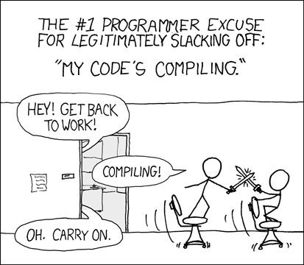
Automation of Test Creation
Relieve cost by automating test creation.
Repetitive tasks that do not
need human attention.
Generate test input.
Need to add assertions.
Or check for crashes, memory leaks, other problems that can be measured automatically.
Automation!
Tests are generating!

Slide 11
Today’s Goals
Introduce Search-Based Test Generation
(AKA: Fuzzing)
Test Creation as a Search Problem
Metaheuristic Search Algorithms
Fitness Functions

Slide 12
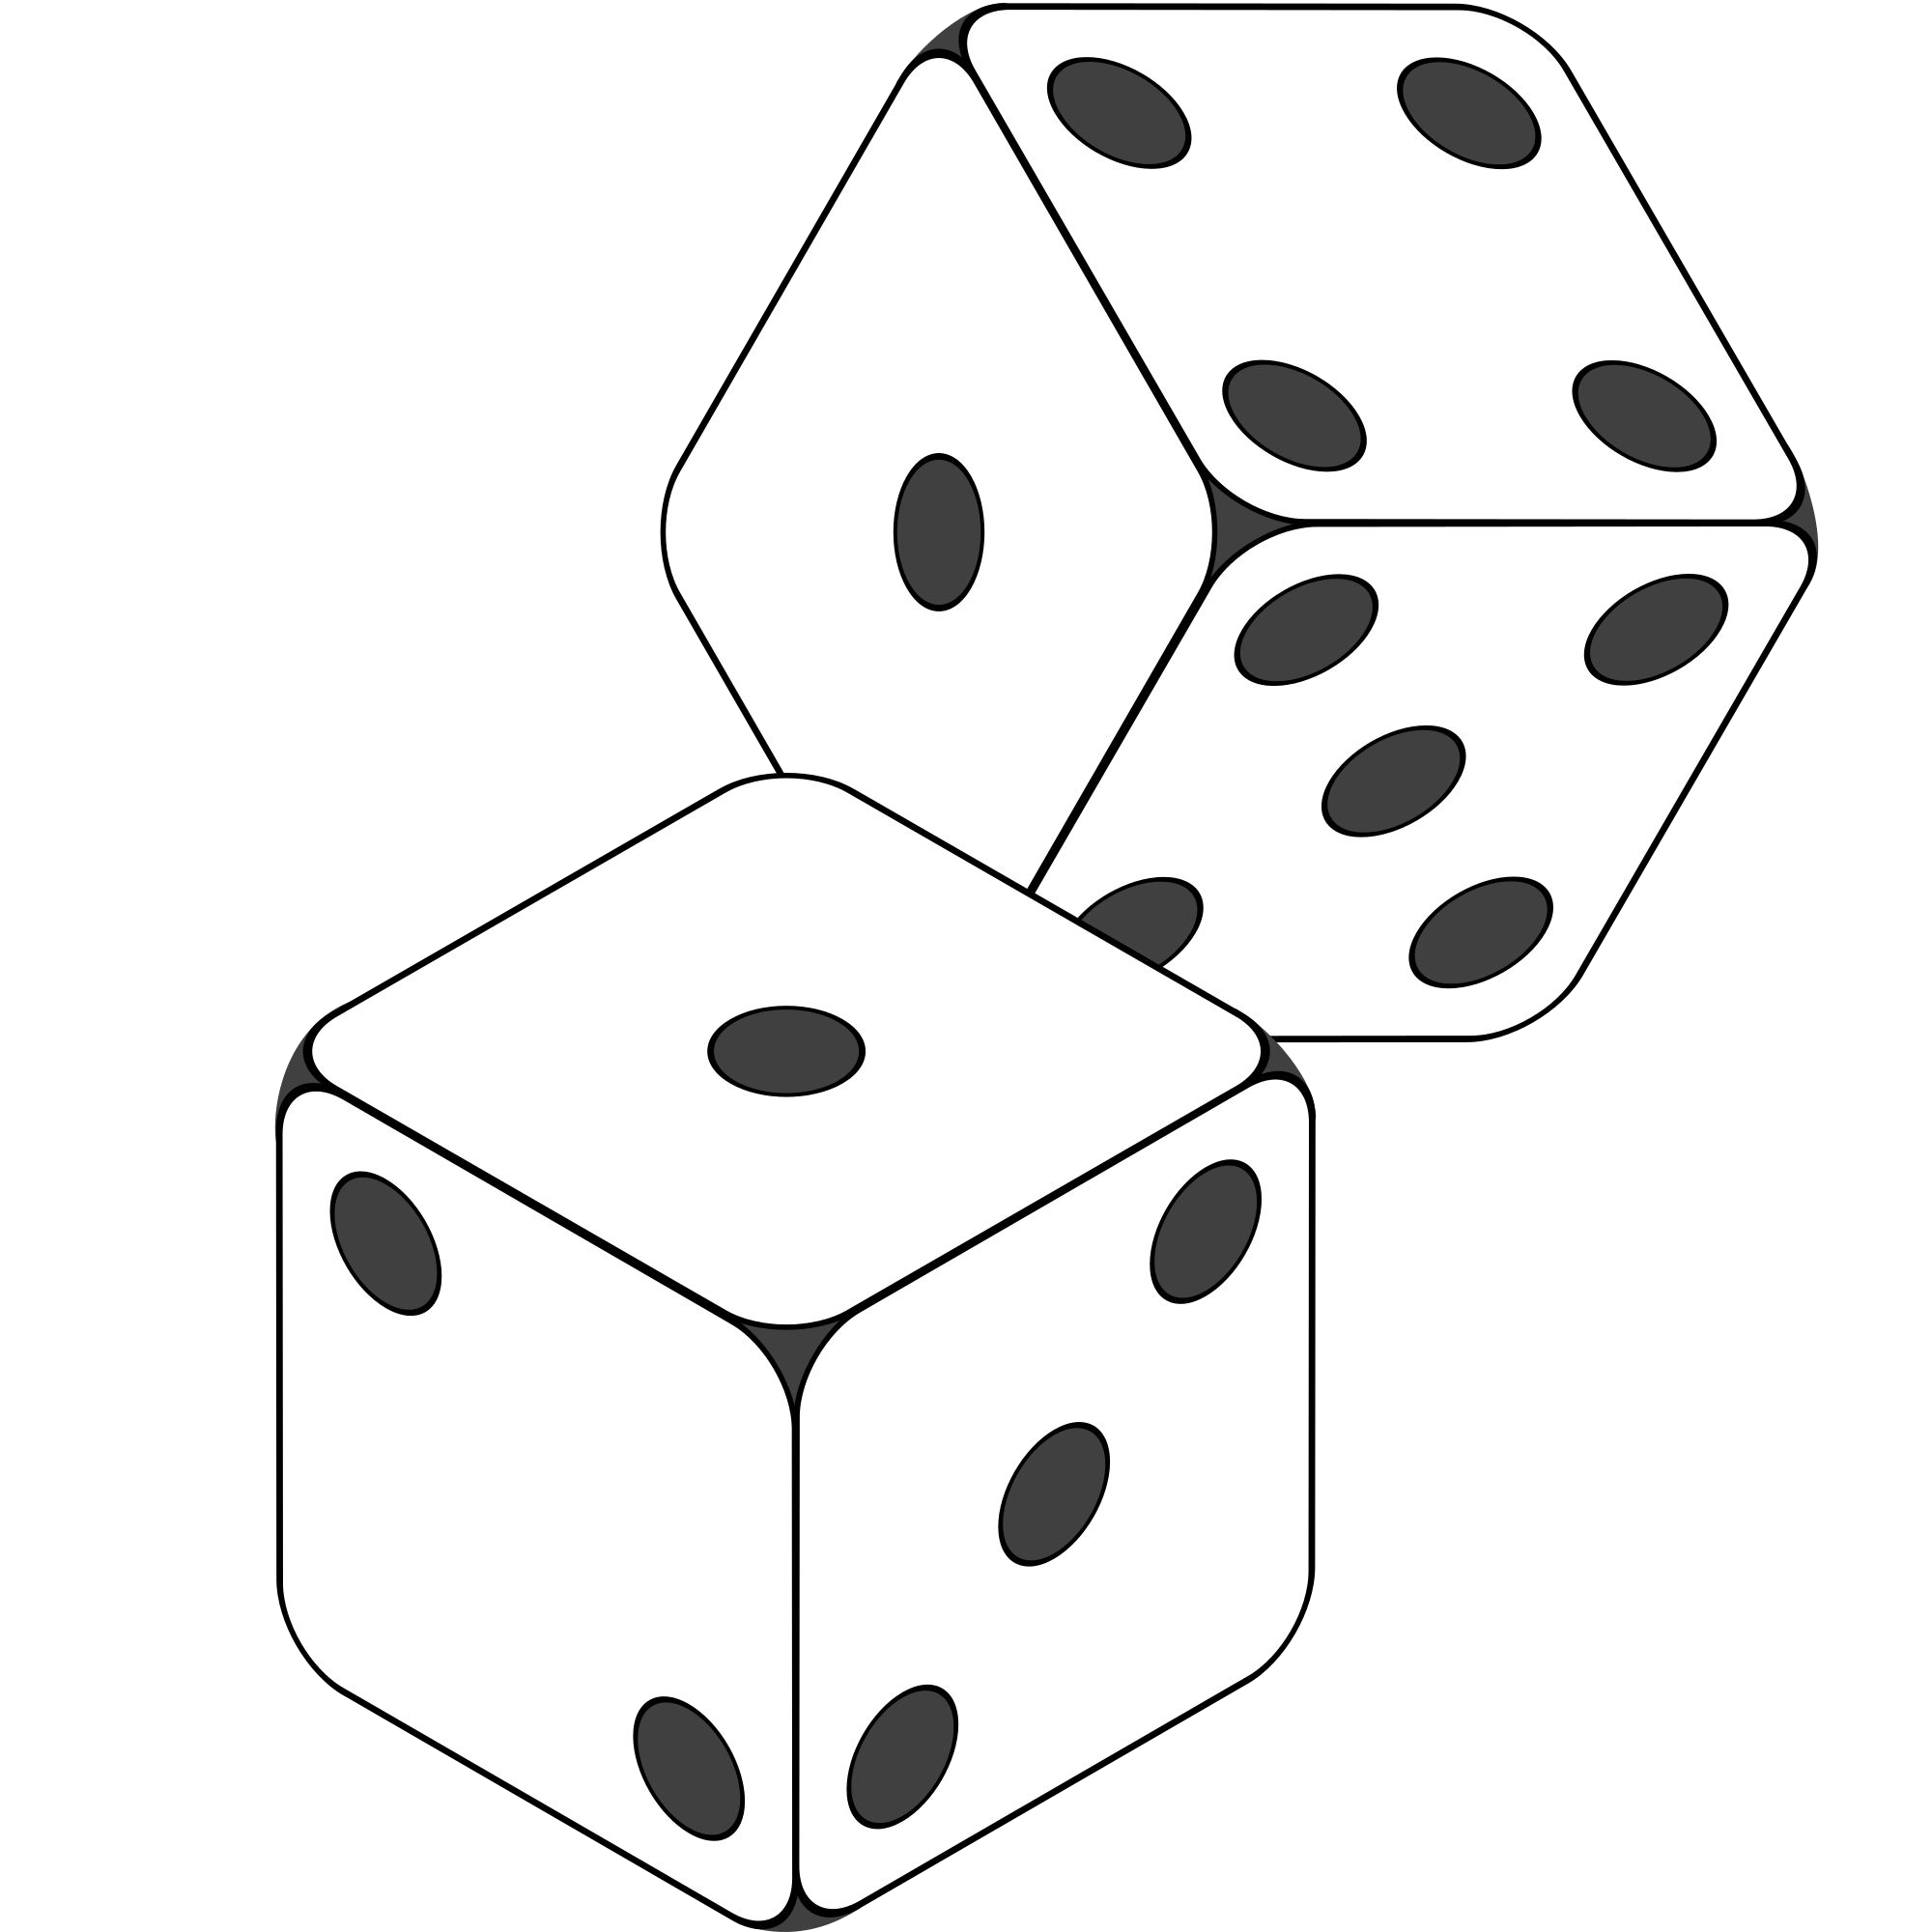
Random Generation
Randomly formulate test cases.
Unit testing: choose a class in the system, choose random methods, call with random parameter values.
System-level testing: choose an interface, choose random functions from interface, call with random values.
Keep trying until goal attained or you run out of time.

Slide 13

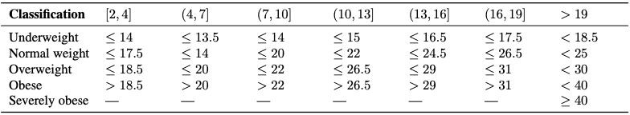
Example - BMI Calculation
BMICalc
height weight age
bmi_value() classify_bmi_adults() classify_bmi_teens_and_children()
Age

Slide 14
Example - BMI Calculation
def test_bmi_value_valid(): bmi_calc = BMICalc(150, 41, 18)
bmi_value = bmi_calc.bmi_value() assert bmi_value == 18.2
def test_bmi_adult():
bmi_calc = BMICalc(160, 65, 21)
bmi_class = bmi_calc.classify_bmi_adults() assert bmi_class == "Overweight"
def test_bmi_children_4y():
bmi_calc = BMICalc(100, 13, 4)
bmi_class = bmi_calc.classify_bmi_teens_and_children() assert bmi_class == "Underweight"
BMICalc
height weight age
bmi_value() classify_bmi_adults() classify_bmi_teens_and_children()

Slide 15
Random Generation - BMI Example
Create an empty test case:
def test_1():
Instantiate the class-under-test with random values:
def test_1():
cut = BMICalc(180, 50, 40)
Insert 1+ method calls or assignments to class variables.
Number of calls is random
Which method/variable is random
Method parameters are random values
BMICalc
height weight age
bmi_value() classify_bmi_adults() classify_bmi_teens_and_children()
def test_1():
cut = BMICalc(180, 50, 40)
output = cut.bmi_value() cut.height = 15681
output2 = cut.classify_bmi_adults()

Slide 16
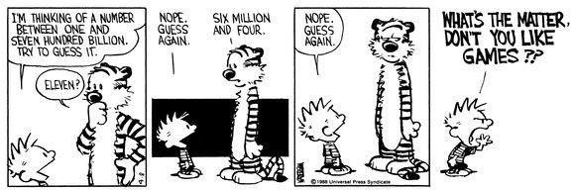
Random Search
Sometime viable:
Extremely fast.
Easy to implement, easy to understand.
All inputs considered equal, so no designer bias.
However…

Slide 17
Test Creation as a Search Problem
Do you have a goal in mind when testing?
Make the program crash, achieve code coverage, cover all 2-way interactions, …
You are searching for a test suite that achieves that goal.
Search-based test generation based on
guess-and-check process.

Slide 18
Test Creation as a Search Problem
Many testing goals can be measured:
How many exceptions were thrown?
How many representative output values were returned?
What percentage of lines of code were covered?
How diverse is our input?
If goal can be measured, search can be automated.

Slide 19

Search-Based Test Generation
Make one or more guesses.
Generate one or more individual test cases or full test suites.
Check whether goal is met.
Score each guess.
Try until time runs out.
Alter the solution based on feedback and try again!

Slide 20
Search Strategy
The order that solutions are tried is the key to efficiently finding a solution.
A search follows some defined strategy.
Called a “metaheuristic”.
Metaheuristics are used to choose solutions and to ignore solutions known to be unviable.
Smarter than pure random guessing!

Slide 21
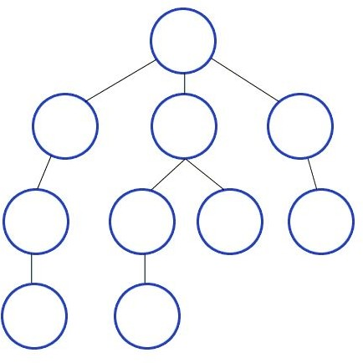
Heuristics - Graph Search
Arrange nodes into a hierarchy.
Breadth-first search looks at all nodes on the same level.
Depth-first search drops down hierarchy until backtracking must occur.
Attempt to estimate shortest path.
A* search examines distance traveled and estimates optimal next step.
Requires domain-specific scoring function.

Slide 22
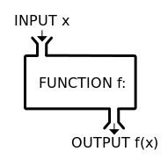


Search-Based Test Generation
+ =
The Metaheuristic (Sampling Strategy)
The Fitness Functions (Feedback Strategies)
(Goals)
Genetic Algorithm Simulated Annealing Hill Climber
(...)
Distance to Coverage Goals Count of Executions Thrown Input or Output Diversity (...)
Cause Crashes Cover Code Structure,
Generate Covering Array, (...)

Slide 23
Metaheuristic Algorithms

Slide 24
The Metaheuristic
Decides how to select and revise solutions.
Changes approach based on past guesses.
Fitness functions give feedback.
Population mechanisms choose new solutions and determine how solutions evolve.

Slide 25
The Metaheuristic
Decides how to select and revise solutions.
Small changes to single solution (local search) or larger changes to multiple solutions (global search).
Often based on natural phenomena (swarm behavior, evolution).
Trade-off between speed, complexity, and understandability.

Slide 26
How Long Do We Spend Searching?
Exhaustive search not viable.
Search can be bound by a search budget.
Number of guesses.
Time allotted to the search (number of minutes/seconds).
Optimization problem:
Best solution possible before running out of budget.

Slide 27
Local Search
Generate and score a single potential solution.
Attempt to improve by looking at its neighborhood.
Make small, incremental improvements.
Very fast, efficient if good initial guess.
Get “stuck” if bad guess.
Often include reset strategies.

Slide 28

Hill Climbing
Generate a random initial solution.
Each generation (while budget remains):
Attempt up to max_tries mutations to the solution.
If a mutation results in a better solution, set this as the new solution.
Keep track of the best mutation seen to date.
If we run out of tries, reset to a new random initial solution.

Slide 29
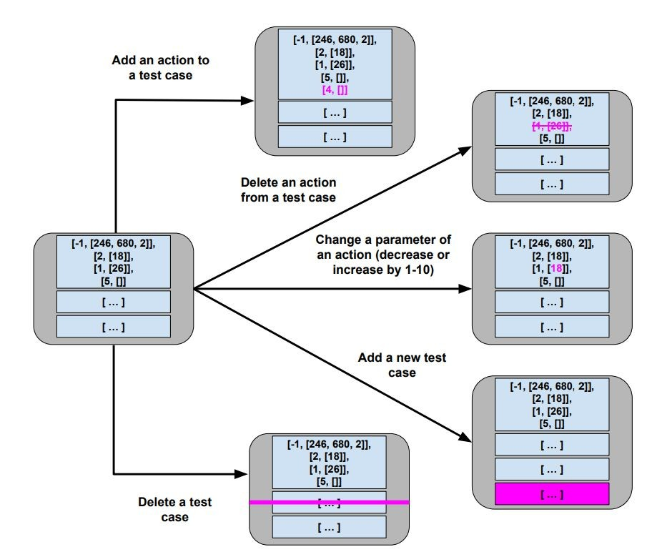
Mutation
Small change to current solution.
Impose one of
these changes at a time:

Slide 30
Hill Climber
User-Controlled Parameters:
Maximum mutations before a restart (ex: 200)
Maximum number of restarts (ex: 5)
Easy to implement, faster than many other metaheuristics.
Reliant on initial guesses and restarts.

Slide 31
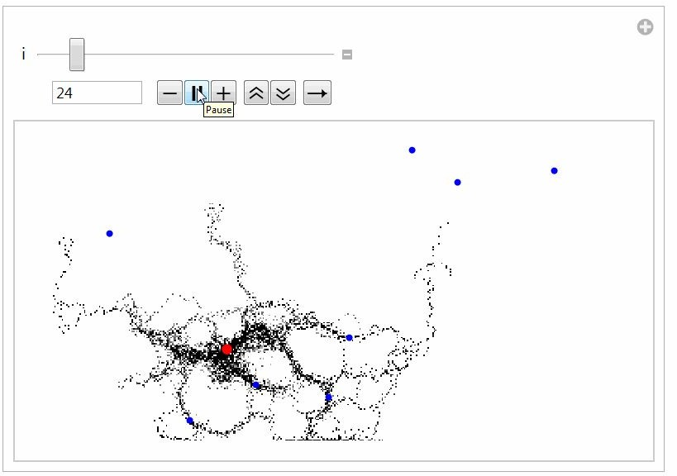
Global Search
Generate multiple solutions.
Evolve by examining whole search space.
Typically based on natural processes.
Swarm patterns, foraging behavior, evolution.
Models of how populations interact and change.

Slide 32
I Want to Try This Out!
Fuzzing often based on metaheuristic search.
AFL (American Fuzzy Lop), Google OSS-Fuzz use genetic algorithms, fitness = code coverage.
http://lcamtuf.coredump.cx/afl/
https://google.github.io/oss-fuz
system-level tests
The Fuzzing Book has tutorials and code for many specialized approaches:
https://www.fuzzingbook.org/

Slide 33
I Want to Try This Out!
Python:
Tutorial for beginners: https://greg4cr.github.io/pdf/21ai4se.pdf
https://github.com/Greg4cr/PythonUnitTestGeneration
EvoSuite for Java: http://www.evosuite.org/
Sapienz (Facebook) tests Android/iOS apps
Will be open-source in end of 2020 2022?.
Older version available
https://github.com/Rhapsod/sapienz/

